Slide 1
Sitakhela Likusasa Impact Evaluation: Financial Incentives to Reduce HIV Incidence among Adolescent Girls and Young Women (AGYW) in Eswatini
PRINCIPAL INVESTIGATORS:
Marelize Görgens, World Bank; Khanyakwezwe Mabuza, Eswatini National Emergency Response Council on HIV/AIDS (NERCHA); Damien de Walque, World Bank
OTHER INVESTIGATORS:
Sosthenes Ketende, World Bank; Vimbai Tsododo, Institute for Health Measurement Africa; Mbuso Mabuza, NERCHA; Wendy Heard, World Bank; Tendai Chiperera, IHM Africa; Tengetile Dlamini, NERCHA; Leroy Shongwe, IHM Africa; Andrew Longosz, World Bank; Lindiwe Dlamini, Ministry of Education and Training, Gcinaphe Dube, SWAGAA, Gugu Maphalela, NRL, David Wilson, World Bank; Muziwethu Nkambule, formerly of NERCHA, and Sitakhela Likusas Study Implementation Team

Slide 2
Study Partners
MINISTRY OF EDUCATION AND TRAINING
KINGDOM OF ESWATINI
MINISTRY OF HEALTH
National Reference Laboratory, and Swaziland National AIDS Programme (SNAP)
KINGDOM OF ESWATINI
Main study implementation partner SGBV counselling and follow up
For baseline survey
For baseline survey

Slide 3
Context & Rationale

Slide 4
Multiple Vulnerabilities of AGYW in Eswatini
High risk sexual behavior cycle because of multiple vulnerability to HIV
Poverty, Socio-economic stressors
Low social status
Limited access to support and services
Low negotiating power
Sex with older partners
Early sexual debut
Late marriage
Transactional sex
Multiple partners
Commercial sex work
Rape and gender-based violence
Teen Pregnancy
School dropout
Only 33% female enrolment in secondary school
Low rates of return after school dropout
High youth unemployment and only 40% female participation in labour market
High and increasing levels of transactional sex
% women aged 15-24 in Eswatini who had sex in the last 12 months with a partner who was 10 or more years older
2007
2010
2014
Source: DHIS 2007, MICS 2010, and MICS 2014
Growing evidence that financial incentives could reduce economic drivers for high-risk sexual behaviour

Slide 5
First, Mathematical Modelling: Potential Future Impact of 5 Core Interventions on HIV incidence and AIDS deaths in Eswatini
Source: World Bank and Burnet Institute, 2014

Slide 6
Intervention and Population

Slide 7
Two kinds of Interventions Implemented in School Years 2016, 2017 and 2018
1. EDUCATION INCENTIVES – definite incentive, if condition (education) met
Incentives paid for enrolling in and attending school (E1400 (~$100) per year)
Incentives paid for enrolling in and completing other education like tertiary education, upgrading or short courses (E1400 (~$100) per year)
Only in 2018, tuition fees paid for out of school participants (up to E2900 (~$200) per course)
2. RAFFLES – possibility of incentive, if condition (no STIs) met
50% of participants also eligible for raffle. 7 raffles held:
In each raffle round, 400 participants randomly selected for STI testing
If negative for syphilis and trichomonas vaginalis, then eligible for raffle prize
80 raffle winners drawn every round, 560 raffle winners in total
Raffle prize money per round: E1000 (~$72)

Slide 8
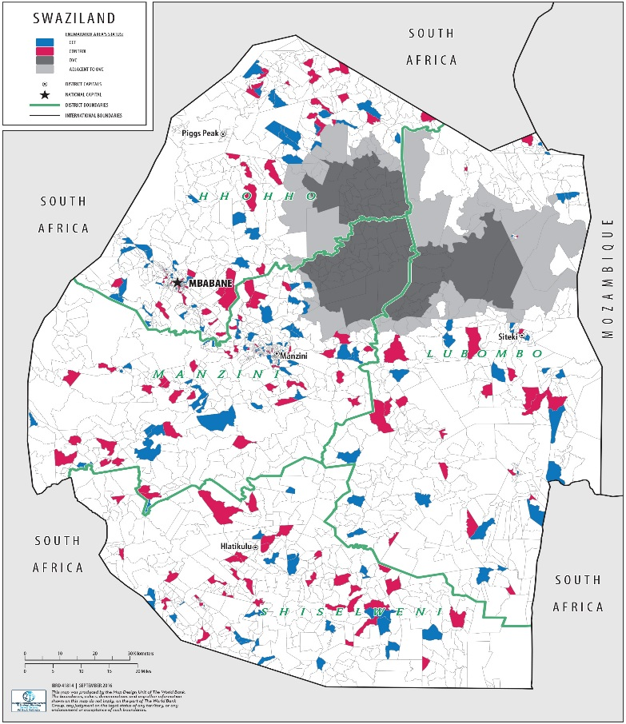
Study Population
Geographic distribution of participants at baseline and endline
From Nov 2015 – March 2016, enrolled 4389 adolescent girls and young women (AGYW) aged 15-22 in Eswatini from 266 enumerator areas
Stratified enrolment:
50% in school or other form of education and 50% out of school or other education
80% from rural enumeration areas and 20% from urban enumeration areas

Slide 9
Design and Intervention Arms
2x2 factorial design
4 study sub-arms

Slide 10
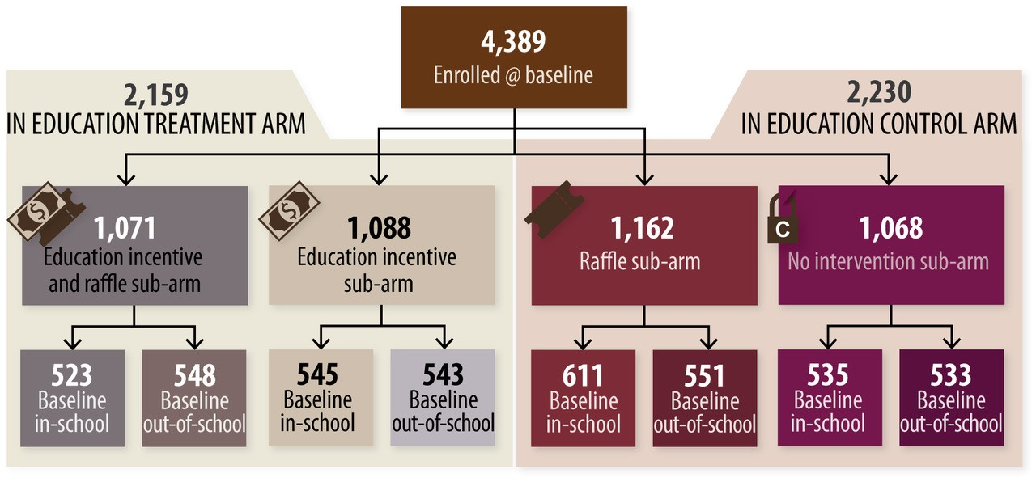
How study population was allocated to 4 sub-arms

Slide 11
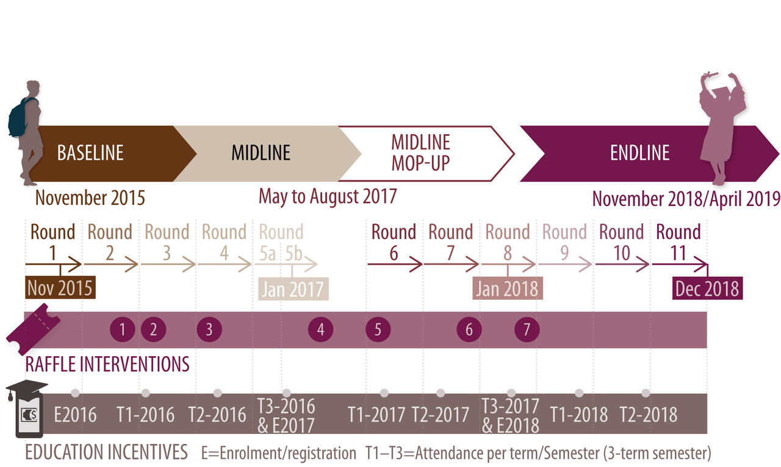
Timeline

Slide 12
Intervention Coverage Summary
1. EDUCATION INCENTIVES
Incentives paid for enrolling in and attending school (E1400 (~$100) per year)
Incentives paid for enrolling in and completing other education like tertiary education, upgrading or short courses (E1400 (~$100) per year)
Only in 2018, tuition fees paid for participants who were out of school at midline (up to E2900 (~$200) per course)
2. RAFFLES
~2200 participants (50%) also eligible for raffle. 7 raffles held:
In each raffle round, 400 participants randomly selected for STI testing
If negative for syphilis and trichomonas vaginalis, then eligible for raffle prize
80 raffle winners drawn every round, 560 raffle winners in total (470 individual winners)
Raffle prize money per round: E1000 (~$72)
59%
31%
19% received prizes

Slide 13
Participation in study endline data collection
Arm of the study | Response Rate at endline
Education Treatment Arm | 87%
Education Control Arm | 85%
Overall Response Rate | 86%
Response rate of 86% at endline > 19% LTFU anticipated at sample design stage

Slide 14
Non-response at endline was not significantly associated with study sub-arm
 | Participated at endline | Did not participate at endline | P-value
No intervention sub-arm | 85.1% | 14.9% | 0.374
Raffle sub-arm | 85.6% | 14.4%
Education incentive only sub-arm | 87.0% | 13.0%
Education incentive and Raffle sub-arm | 87.3% | 12.7%

Slide 15
Results

Slide 16
Evaluation Question 1: Did the education incentives have an impact on new HIV infections?
YES, a significant impact
(Adjusted for raffle incentive) | HIV incidence | P-value | Odds Ratio [95% Confidence Interval] | P-value
Education Control Arm | 8.08% | 0.036 | 1 | 0.037
Education Treatment Arm | 6.34% |  | 0 .77 [0.60- 0.98]
Total | 7.21%
HIV incidence in the education incentive treatment arm was 21% lower than in the education incentive control arm
Participants in the education incentive treatment arm were 23% less likely to become HIV positive

Slide 17
What put participants at risk of getting HIV?
Profile of participant | How likely to have acquired HIV
Being out of school | 190% more likely to have acquired HIV
‘Risk-loving’ participants | 145% more likely to acquire HIV
At education level years 1-5 | 56% less likely to have acquired HIV
Richest 20% of participants | 35% less likely to acquire HIV
At education level Forms 1-6 | 29% less likely to have acquired HIV
‘Risk-loving’ participants: during surveys, played a game with participants to assess their propensity to take risk when it comes to financial decision making. Based on how they responded, participants were classified on a scale ranging from risk averse to risk loving.

Slide 18
‘Treatment on the Treated’ Analysis
HIV incidence trends (moving average) amongst those in education treatment arm, by number of incentive payments received (P = 0.003)
Trendline (moving average) for raffle and education incentives, including tuition fee payments

Slide 19
‘Treatment on the Treated’ Analysis: Instrumental Variable Probit Model Results
Instrumented by Education Treatment Arm allocation:
There was a marginal effect of additional payments – for each additional round of education incentive received, HIV incidence was reduced by 3.9 percentage points (p=0.014) “
Also, the TOT risk factor analysis confirmed the ITT risk factor analysis outcomes:
Participants with higher levels of education were less likely to acquire HIV infection
‘Risk-loving’ participants were 18% more likely to acquire HIV – confirming the ITT correlate analysis (p=0.031)

Slide 20
Self-reported education attendance at endline
 | Not enrolled in school | Enrolled in school | P-value
Education incentive treatment arm | 45.3% | 54.7% | <0.001
Education incentive control arm | 54.4% | 45.6%

Slide 21
Evaluation Question 2: Did the raffle on its own have an impact on new HIV infections?
NO, not significant impact
Arm | HIV Incidence over the study period | P-value | Odds Ratio [95% confidence interval] | P-value
Raffle Control Arm | 7.83% | 0.133 | 1 | 0.152
Raffle Treatment Arm | 6.61% |  | 0.833 [0.648 -1.070]

Slide 22
Evaluation Question 3: Did the raffle amplify the impact on HIV incidence?
YES, together, the biggest impact
 | HIV Incidence over the study period | Odds Ratio [95% confidence interval] | P-value
No intervention | 8.84% | 1
Raffle only | 7.38% | 0.82 [0.59, 1.14] | 0.245
Education only | 6.87% | 0.76 [0.54, 1.07] | 0.116
Education and Raffle | 5.79% | 0.63 [0.44, 0.91] | 0.013
35% difference in HIV incidence between no intervention sub-arm and the raffle and education sub-arm
Participants in the raffle and incentive sub-arm compared to no intervention arm were 37% less likely to have acquired HIV

Slide 23
Next Steps
Additional quantitative analysis focusing on secondary research questions
Expand treatment-on-the-treated analyses
Conduct benefit-cost analysis
Conclude qualitative research
Academic publication and national dissemination

